Slide 1
TAA Group
Chartpackage Macro
PENSIONSKASSE DER CREDIT SUISSE GROUP (SCHWEIZ)
Investment Management
18.06.2025
Intern

Slide 2
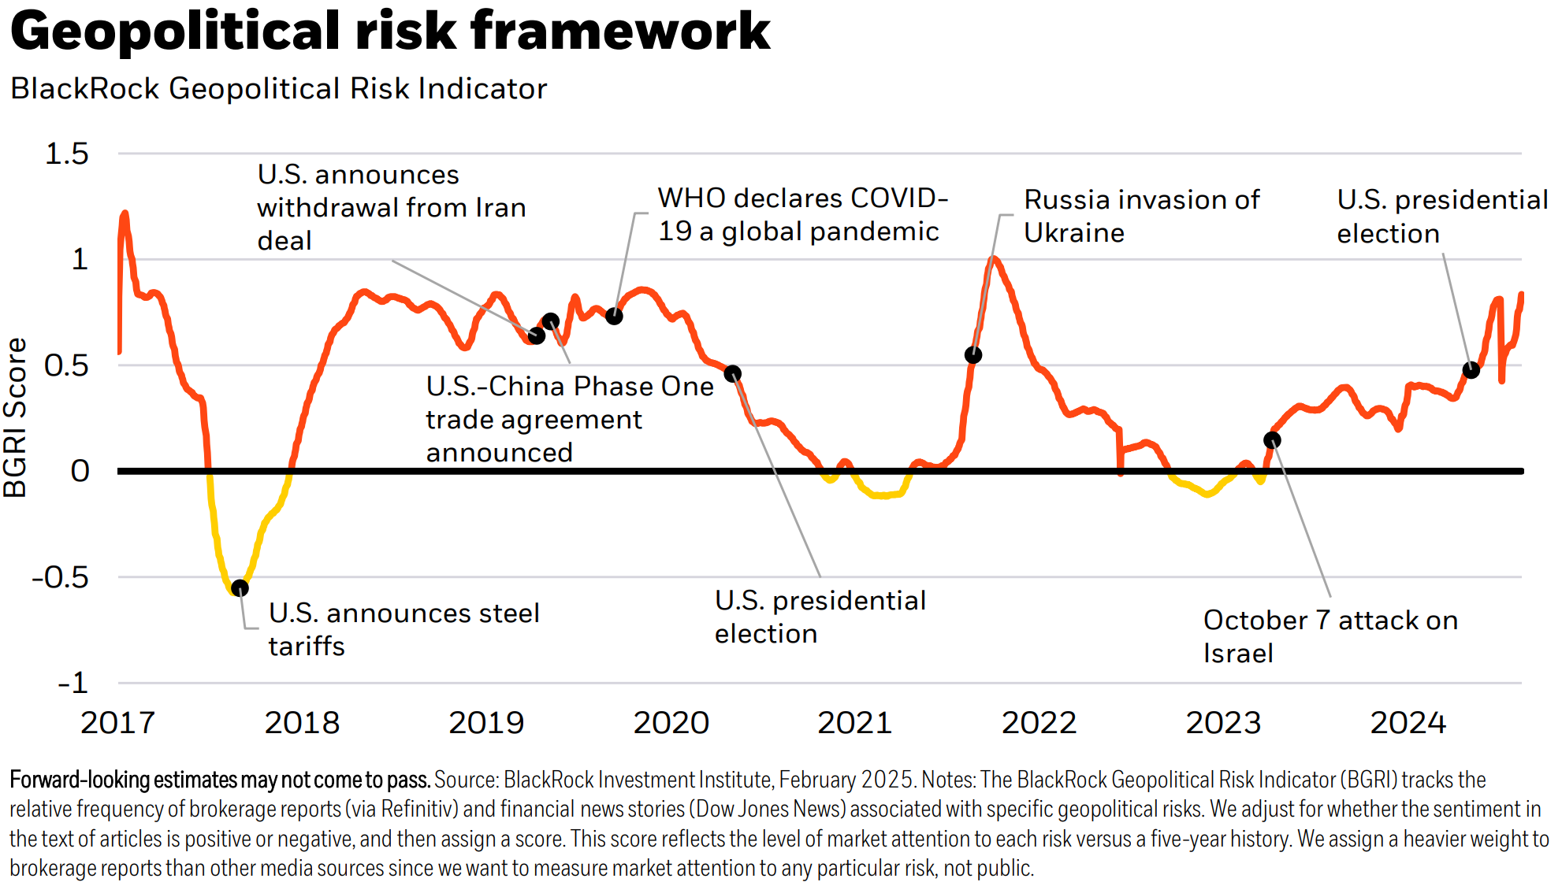
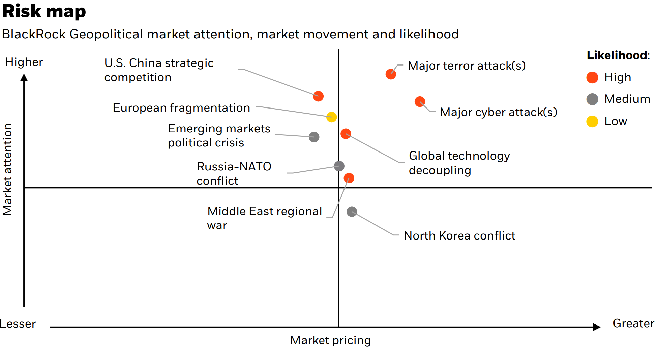
Factor View Anlagebereich
Risikolandschaft
Quelle: Blackrock, Macrobond
Notes:
Geopolitical Risk Dashboard | BlackRock Investment Institute
Reports | World Economic Forum (weforum.org)

Slide 3
Macro

Slide 4
Macro
Growth
GDP Growth: Forecasts 2025
Quelle: Macrobond

Slide 5
Macro
Growth
GDP Growth: Forecasts 2026
Quelle: Macrobond

Slide 6
Macro
Growth
GDP Growth: Forecasts
Quelle: Macrobond

Slide 7
Macro
Growth
GDP Growth: Forecasts 2025
Quelle: Macrobond

Slide 8
Macro
Growth
GDP Growth: Nowcast
Notes:
Publication Page - J.P. Morgan Markets (jpmorgan.com)

Slide 9
Macro
Leading Indicators
Leading Indicators: PMI
Quelle: Macrobond

Slide 10
Macro
Leading Indicators
Leading Indicators: PMI
Quelle: Macrobond

Slide 11
Macro
Leading Indicators
Leading Indicators: Inventory
Quelle: Macrobond

Slide 12
Macro
Leading Indicators
Leading Indicators: Shipping
Quelle: Macrobond

Slide 13
Macro
Leading Indicators
Leading Indicators: Surprise Indices
Quelle: Macrobond

Slide 14
Macro
Leading Indicators
Leading Indicators: Confidence
Quelle: Macrobond

Slide 15
Macro
Leading Indicators
Leading Indicators: Sentix Economic Index
Quelle: Macrobond

Slide 16
Macro
Business Cycle
Business Cycle: Indices
Quelle: Macrobond

Slide 17
Macro
Business Cycle
Business Cycle: Equity/Bond, Credit Impulse
Quelle: Macrobond

Slide 18
Macro
Business Cycle
Business Cycle: Private Sector Debt
Quelle: Macrobond

Slide 19
Macro
Business Cycle
Business Cycle: Public Sector Debt
Quelle: Macrobond

Slide 20
Macro
Business Cycle
Business Cycle: Debt
Quelle: Macrobond

Slide 21
Macro
Business Cycle
Business Cycle: Debt
Quelle: Macrobond

Slide 22
Macro
Business Cycle
Business Cycle: Central Bank Policy Cycles
Quelle: Macrobond

Slide 23
Macro
Business Cycle
Business Cycle: Saving Rates
Quelle: Macrobond

Slide 24
Macro
Business Cycle
Business Cycle: Saving Rate, Unemployment
Quelle: Macrobond

Slide 25
Macro
Business Cycle
Business Cycle: Emerging Markets Equity vs. Liquidity
Quelle: Macrobond

Slide 26
Macro
Inflation
Inflation: Forecasts
Quelle: Macrobond

Slide 27
Macro
Inflation
Inflation: Forecasts
Quelle: Macrobond

Slide 28
Macro
Inflation
Inflation: Market Expectations and Leading Indicators
Quelle: Macrobond, Bloomberg

Slide 29
Macro
Inflation
Inflation
Quelle: Macrobond

Slide 30
Macro
Inflation
Inflation Europa und Schweiz
Quelle: Macrobond

Slide 31
Macro
Inflation
Inflation USA
Quelle: Macrobond

Slide 32
Macro
Inflation
Inflation Europa
Quelle: Macrobond

Slide 33
Macro
Inflation
Inflation Schweiz
Quelle: Macrobond

Slide 34
Macro
Central Bank Policy
Geldpolitik

Slide 35
Macro
Central Bank Policy
Geldpolitik

Slide 36
Macro
U.S. Housing
Themes: US Housing

Slide 37
Macro
U.S. Banks
Themes: US Term Premium

Slide 38
Macro
U.S. Banks
Themes: US Banks

Slide 39
Macro
U.S. Consumer
Themes: US Consumer

Slide 40
Macro
China
Themes: China

